Slide 1
Litter Recognition 1 - Bi-weekly Progress 24th January
Presented by Jude, Ryan, Jack, Hanzhong, and Sriram.

Slide 2
Ryan - Client Liaison
Wrote code to convert our incomplete .pb model file into a tflite file for use on the Raspberry Pi.
Converted our label map to a valid format for use for inference on the Raspberry Pi.
Began writing inference code to perform live object detection on the Raspberry Pi using Pi Cam 2.
Set up more GitHub Actions to automate the development process.
Laid out our remaining Epics onto our Kanban board.

Slide 3
Jack
Planning to add feature to calculate a positional vector based off two images and bounding boxes
Assisted Jude in attempting to set up the raspberry pi

Slide 4
Sriram
Developed and implemented comprehensive test cases to validate the functionality of the Braccio robotic arm.
Enhanced the Pygame interface to display real-time servo angles, improving monitoring and debugging capabilities.
Integrated more GitHub Actions to streamline and automate the development workflow.
Currently working on converting calculated distances to enable the Braccio arm to accurately locate and pick up objects.

Slide 5
Hanzhong
Try to get degree calculator done

Slide 6
Jude - Project Managing
Work on raspberry pi hardware to set up github and remote ssh connections
Worked with group to test picams
Calculated function for robot arm to move to any location
Set up short term project goals

Slide 7
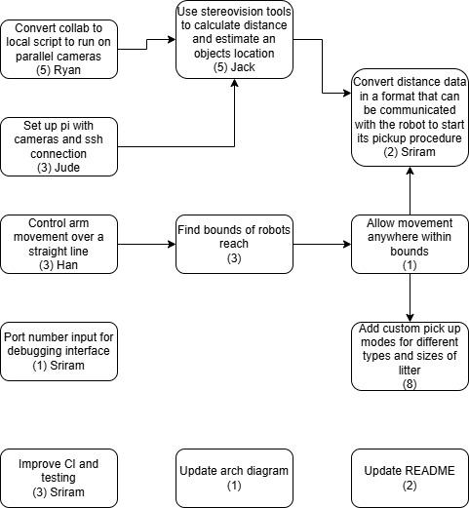
What’s next?

Slide 8
The End:
Discuss the release of the beta.

